Slide 1
Using Cloud File Storage
Enterprise Architecture – Data Architecture, with examples
using MS .NET Blazor, Azure and GreatIdeaz trellispark

Slide 2
Overview
What is cloud file storage?
What are some example technologies?
Common issues in implementation?
DEMO – Uploading Files
DEMO – Downloading Files
Why use this approach?

Slide 3
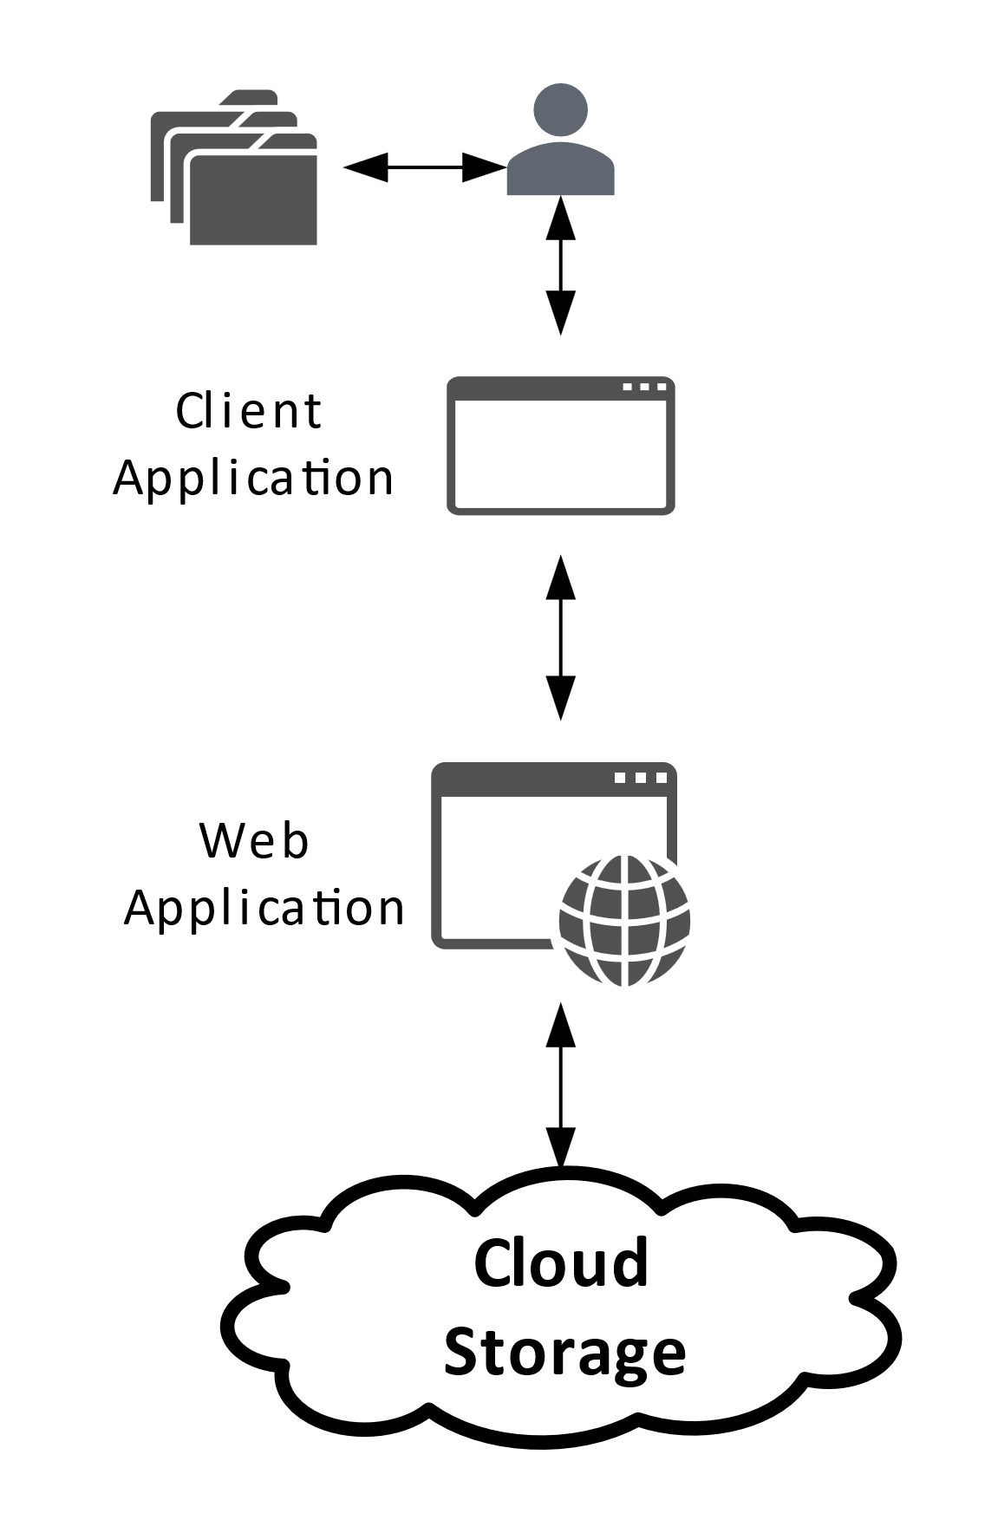
What is cloud file storage?
Transferring files to and from a client device into the cloud

Slide 4
What are some example technologies?
Storage solutions
AWS, Azure and GCP
On Premise – File Servers
Associated technologies
Firewalls, Encryption and Security
Anti-virus, Data Loss Prevention
API Gateways
Content Delivery Networks

Slide 5
Common issues with implementation?
Client connects directly to cloud storage
Sharing connection and secret information
Every instance is hard coded against its corresponding service
Not maximizing code reuse
Non-standard implementation and library
Typically not implementing common patterns
Auto retry on failure
Circuit breaker
Etc.

Slide 6
DEMO – Uploading Files

Slide 7
DEMO – Downloading files

Slide 8
Why use this approach?
You have to build a mechanism for file storage
This is a standard mechanism for all service providers
Creates a central point of control
Consolidates connection and secret information
Can be easily extended to include sophisticated storage patterns

