Slide 1
Asynchronous Messaging
Enterprise Architecture – Data Architecture, with examples
using MS .NET Blazor, Azure and GreatIdeaz trellispark

Slide 2
Overview
What is asynchronous messaging?
What are some example technologies?
Common issues in implementation?
Optimal messaging architecture?
DEMO – Outbound messaging
DEMO – Inbound messaging
Why use this approach?

Slide 3
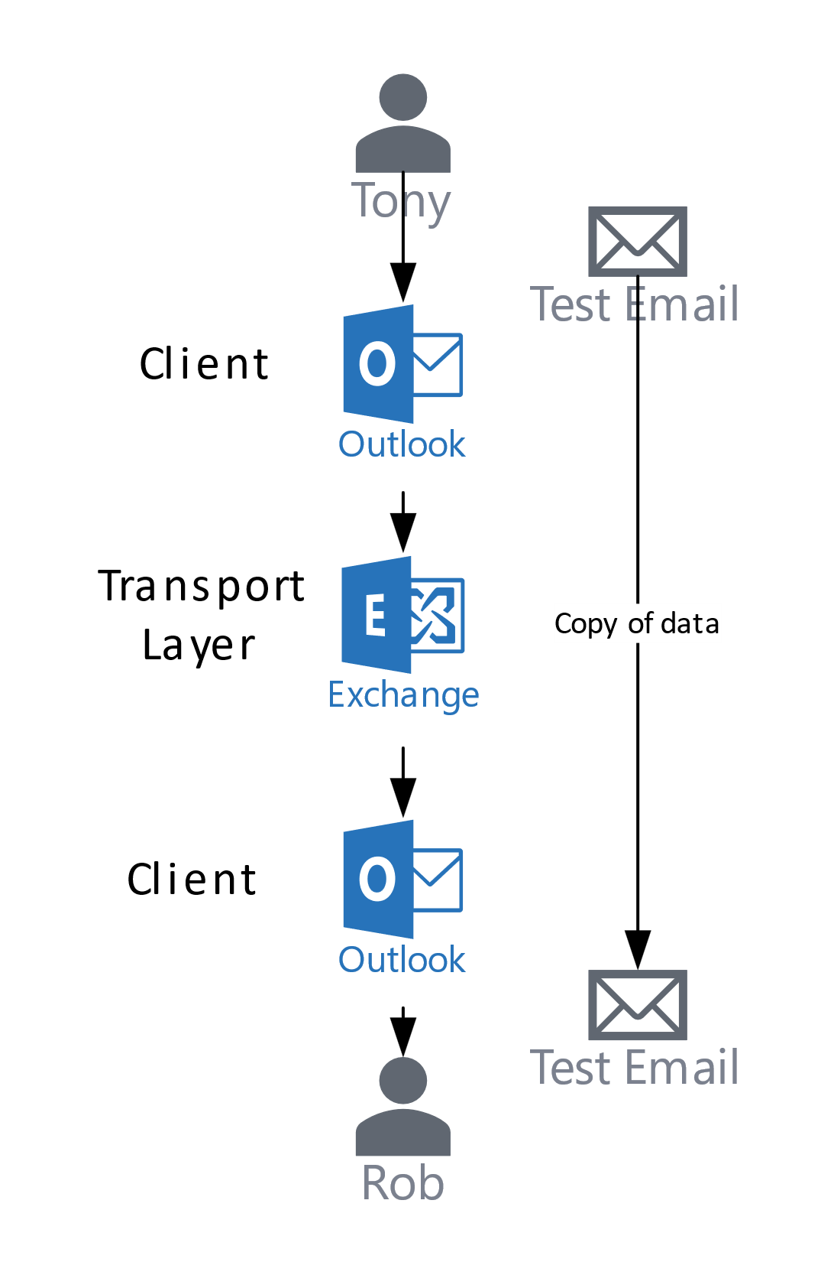
What is asynchronous messaging?
Transfer of data between two actors using a buffering mechanism

Slide 4
What are some example technologies?
Common formats that you would be familiar with:
Email
SMS, Facebook, Twitter, LinkedIn, Instagram, etc.
More application workflow focused?
(s)FTP and shared file storage
Message Queues (Azure, AWS, GCP)
(Enterprise) Service Bus (Queues and Topics)
Custom built solutions

Slide 5
Common issues with implementation?
Every instance is hard coded against its corresponding service
Not maximizing code reuse
Non-standard implementation and library
Sharing connection and secret information
Synchronous connection to target service
Typically not implementing common patterns
Internal asynchronous buffering
Auto retry on failure
Circuit breaker
Etc.

Slide 6
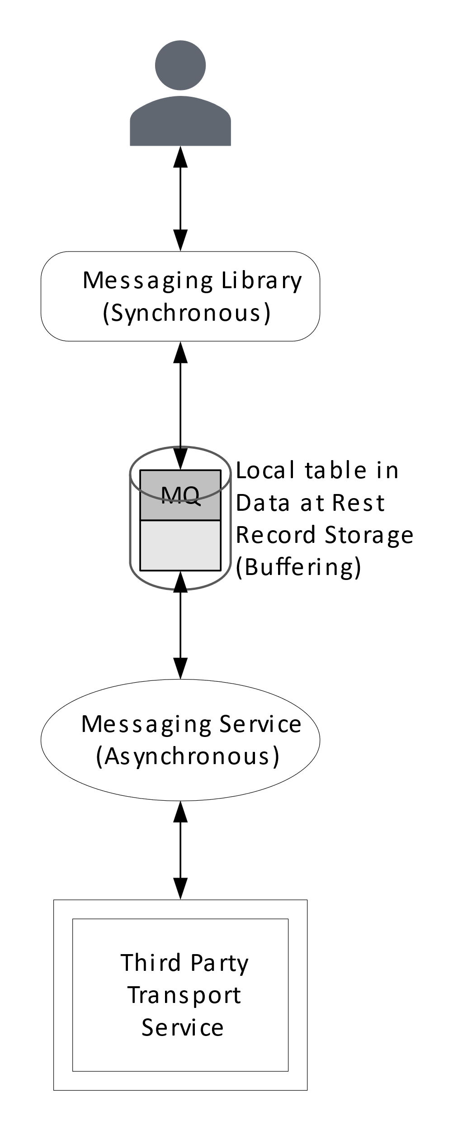
Optimal messaging architecture?
Synchronous send/read to local message buffer
Asynchronous send/read to remote third party transport service
Messaging service provides a central focus of control and standardisation
Should be able to transport data over any protocol

Slide 7
DEMO - Outbound messaging

Slide 8
DEMO – Inbound messaging

Slide 9
Why use this approach?
You have to build a mechanism for asynchronous data transport
This is a standard mechanism for all transport protocols
Creates a central point of control
Consolidates connection and secret information
Can be easily extended to include sophisticated messaging patterns
Ensures that messaging is buffered so that user experience and workflow are not delayed

